Slide 1
Topic: Total Surface Area
EQ: How do you calculate the total surface area of a cylinder and composite prisms?

Slide 2
Learning Intentions
Students will be able to
- calculate the TSA of a cylinder
- define a composite solid
determine the surface areas of composite solids by considering the individual solids from which they are constructed

Slide 3

24
7
30
Date
Total Surface Area
EQ – How do I calculate the surface area of cylinders and composite prisms?
Review: The surface area of a shape is how much space is visible on the outside (if you dunked the shape into a pot of paint, it’s the area that would become coloured).
What is the surface area of a shape?
5
Notes:
Input

Slide 4
Surface Area - Cylinder
Now we know that a cylinder’s net is made up of two circles and a rectangle, but what are the dimensions?
The height of the rectangle is the height of the original cylinder, but what about the width?
For the width, we need to know the circumference of the circular ends.

Slide 5
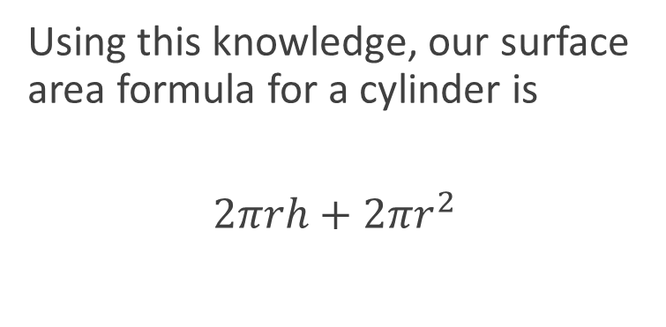
Surface Area - Cylinder
Using this knowledge, our surface area formula for a cylinder is
$$2πrh+2πr^{2}$$

Slide 6
24
7
30
Date
Surface Area
EQ – How do I calculate the surface area of cylinders and composite prisms?
How do I find the surface area of a cylinder?
Calculate the surface area of a cylinder with radius 3cm and height 5cm.
Formula = $2πrh+2πr^{2}$
Substitute in our values
Surface area $=2π×3×5+2π3^{2}$ $=30π+18π$ $=48π$cm²
5
Notes:
Input

Slide 7
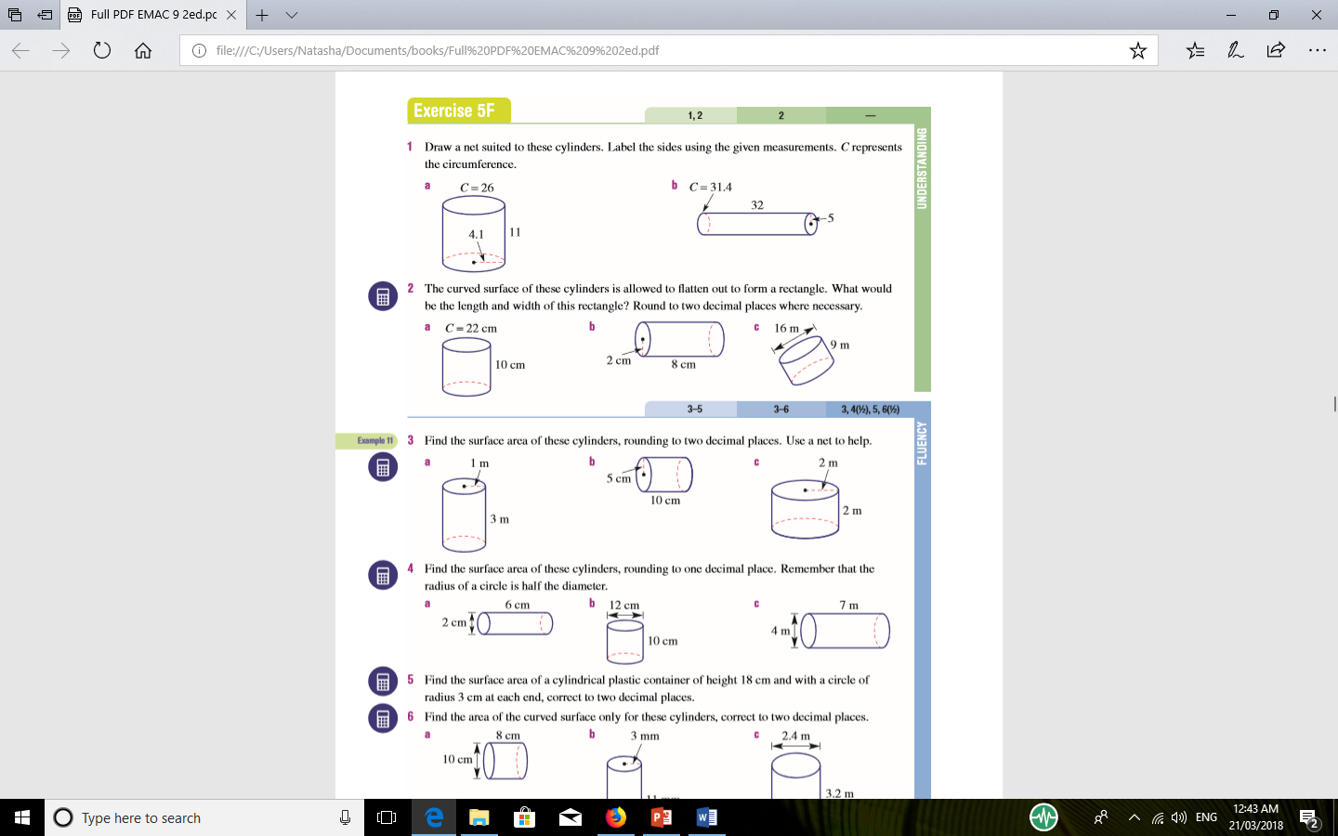

Slide 8
Your Turn- EXIT PASS
Grab your white boards or blank pieces of papers and keep your formulae prepared in front of you.
Calculate the surface area for the upcoming shape (keep π as π in your answers).

Slide 9
Question 1
Calculate the surface area of a cylinder with radius 3cm and height 9cm.
Answer:
Formula $=2πrh+2πr^{2}$
$54π+18π=72π$cm²

Slide 10
24
7
30
Date
Surface Area
EQ – How do I calculate the surface area of cylinders and composite prisms?
What are composite solids?
Hints:
Draw diagram and add in measurements
Name/Label the faces on your diagram
Identify the faces in your working. This will keep you and the assessor of your work from getting lost
Steps:
Identify the individual solids
Find the surface area of each solid
Add surface areas to find the TSA of the composite solid
Subtract non-surface areas form total
How do I find the surface area of composite solids?
Notes:
Input

Slide 11
24
7
30
Date
Surface Area
EQ – How do I calculate the surface area of cylinders and composite prisms?
2 column notes now
Use Surface area worksheet Q1-3
Notes:
Input

